Slide 1
Bioinformatics （生物信息学） BME1063.01 Lecture2 Class2
张力烨
Notes:
Note: do not distribute the slides

Slide 2
week2.class2
1. Introduction about the short read alignment algorithm
2. Introduction about quality control on sequencing data in general

Slide 3

Precision and recall
Notes:
Fig. 1. (A) Precision and recall by amount of variation for 4 datasets, by polymorphism: (number of SNPs, Indel size). (X, Y): reads/read pairs containing X SNPs, where the larges indel is of size Y, as well as errors. (B) Running times (in min) of each tool on 6 × 10<sup>6</sup> reads from each dataset while utilizing an 8 core 3.0 GHz Intel Xeon machine with 16 GB RAM.
3

Slide 4
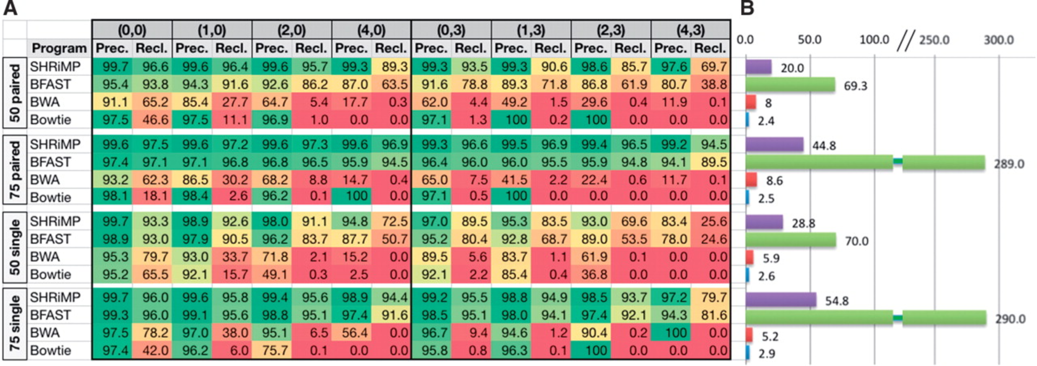
Smith-Waterman short read aligner: SHRiMP
From: SHRiMP2: Sensitive yet Practical Short Read Mapping
Bioinformatics. 2011;27(7):1011-1012. doi:10.1093/bioinformatics/btr046
Bioinformatics | © The Author 2011. Published by Oxford University Press. All rights reserved. For Permissions, please email: journals.permissions@oup.com
Notes:
Fig. 1. (A) Precision and recall by amount of variation for 4 datasets, by polymorphism: (number of SNPs, Indel size). (X, Y): reads/read pairs containing X SNPs, where the larges indel is of size Y, as well as errors. (B) Running times (in min) of each tool on 6 × 10<sup>6</sup> reads from each dataset while utilizing an 8 core 3.0 GHz Intel Xeon machine with 16 GB RAM.
4

Slide 5
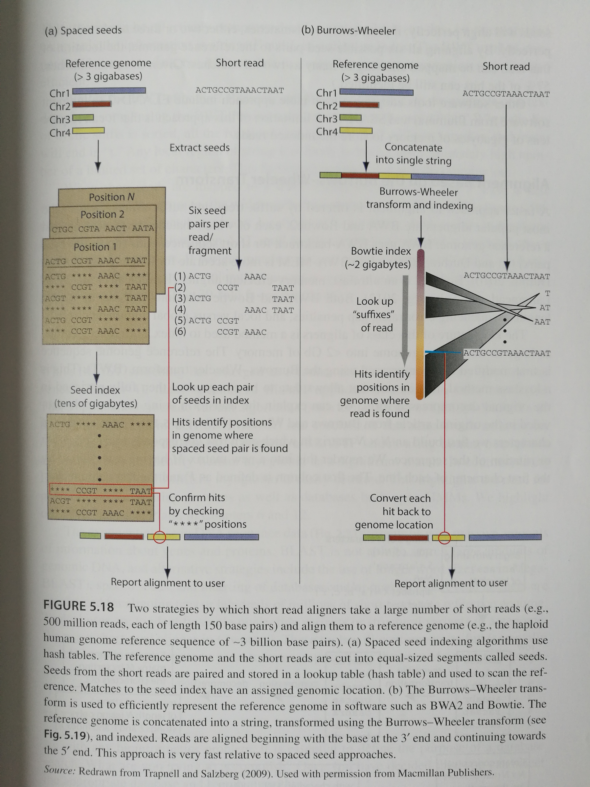
Burrows-Wheeler transformation indexing
SHRiMP
BWA/Bowtie
Bioinformatics and Functional genomics, 3rd, page 195
Notes:
Who can describe the method
What else does this guy do?
Techonology is very important

Slide 6
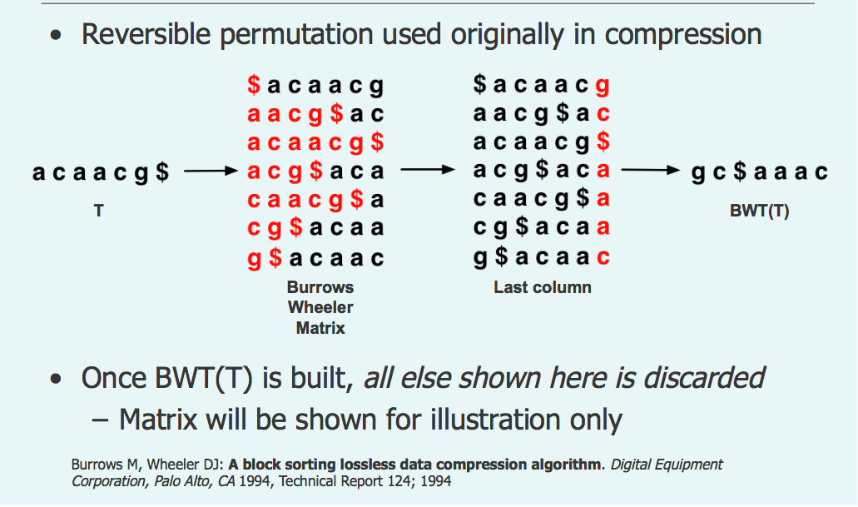
Burrow Wheelers transform
Ben Langmead NCI Seminar Nov 10, 2008
Notes:
Which version you should use? Concern: what is already processed.. // general the later the better. // Also the annotation files has to be consistent.
If all your data is processed in one version and you try to use processed data from another version.

Slide 7
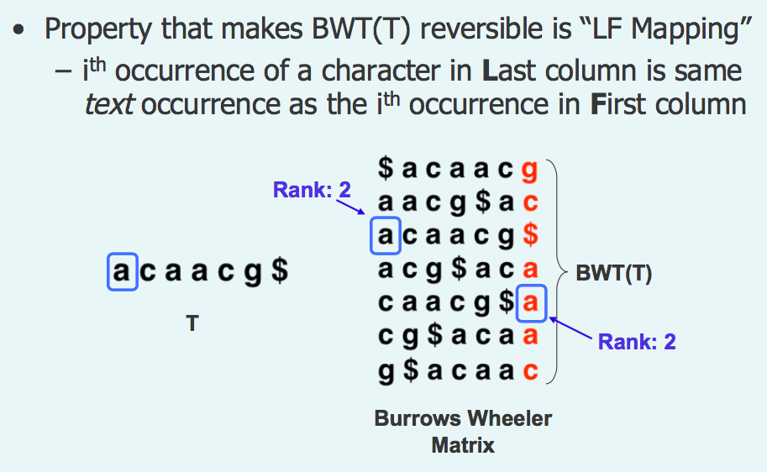
BW transform properties
Ben Langmead NCI Seminar Nov 10, 2008
Notes:
Which version you should use? Concern: what is already processed.. // general the later the better. // Also the annotation files has to be consistent.
If all your data is processed in one version and you try to use processed data from another version.

Slide 8
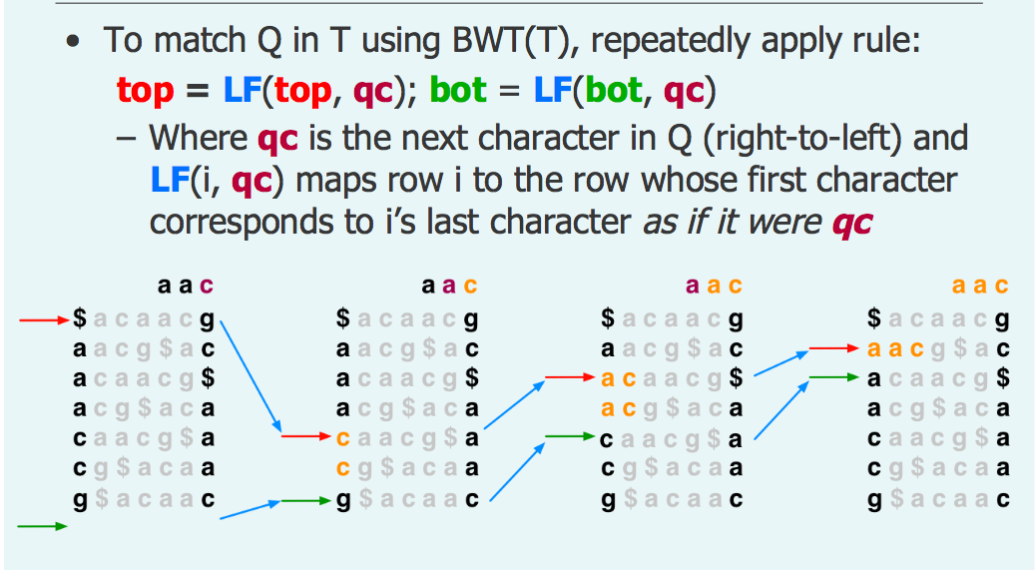
Exact Match with BWT
Ben Langmead NCI Seminar Nov 10, 2008
Notes:
Which version you should use? Concern: what is already processed.. // general the later the better. // Also the annotation files has to be consistent.
If all your data is processed in one version and you try to use processed data from another version.

Slide 9
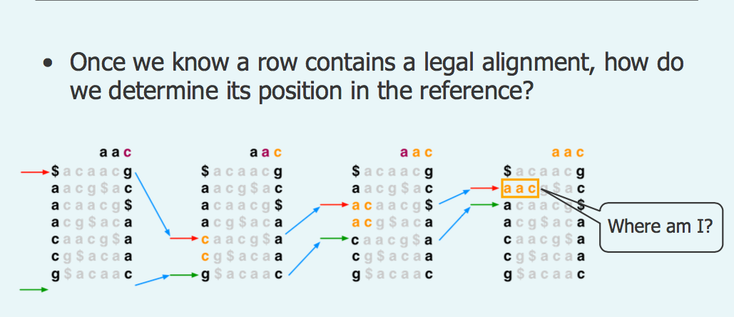
How to determine the location of the mapping
Ben Langmead NCI Seminar Nov 10, 2008
Notes:
Which version you should use? Concern: what is already processed.. // general the later the better. // Also the annotation files has to be consistent.
If all your data is processed in one version and you try to use processed data from another version.

Slide 10
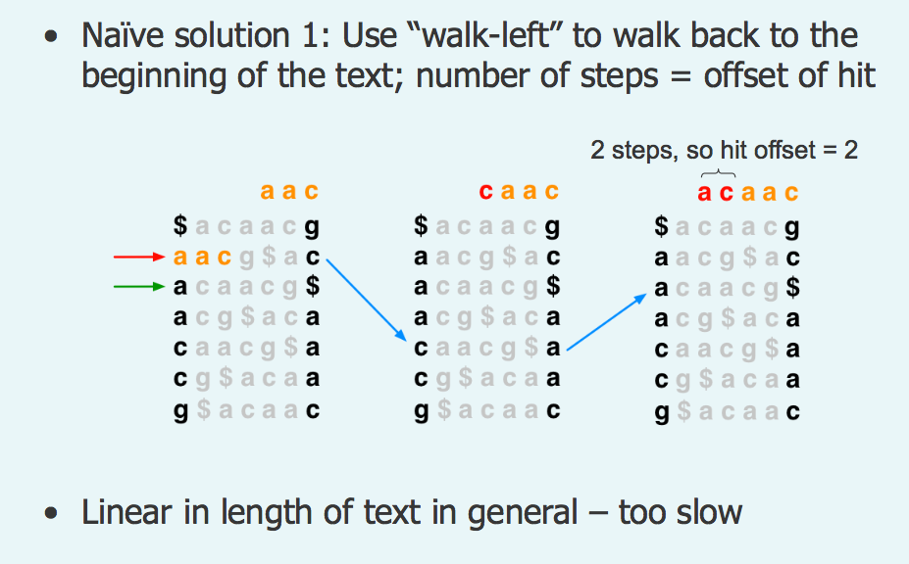
Solution: walk back to the end
Ben Langmead NCI Seminar Nov 10, 2008
Notes:
Which version you should use? Concern: what is already processed.. // general the later the better. // Also the annotation files has to be consistent.
If all your data is processed in one version and you try to use processed data from another version.

Slide 11
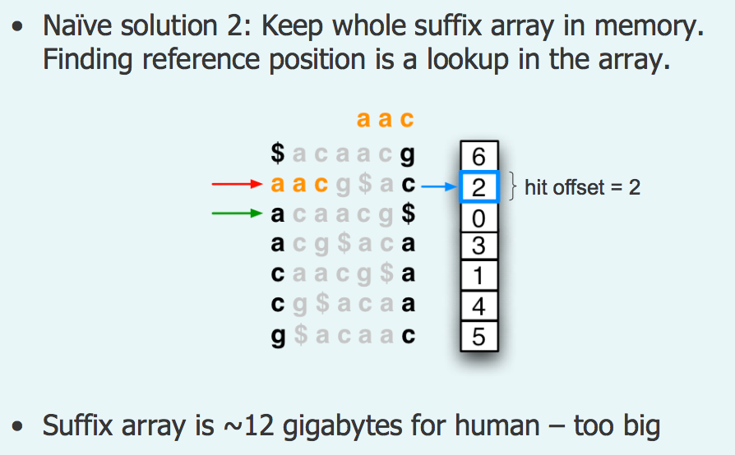
Solution: store the whole reference offset in memory
Ben Langmead NCI Seminar Nov 10, 2008
Notes:
Which version you should use? Concern: what is already processed.. // general the later the better. // Also the annotation files has to be consistent.
If all your data is processed in one version and you try to use processed data from another version.

Slide 12
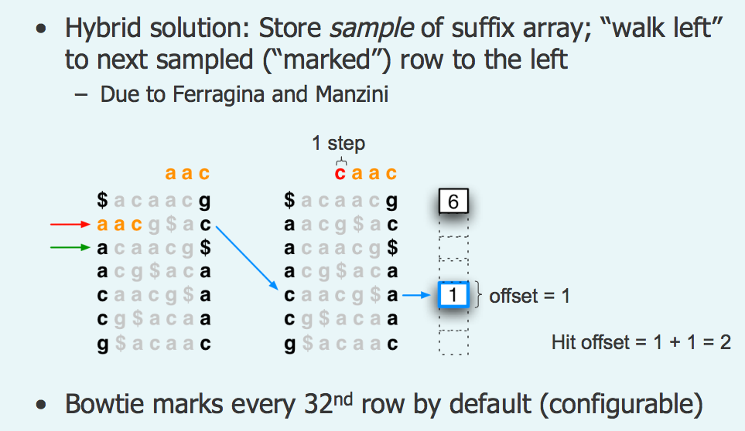
Solution: hybrid solution to achieve balance in speed and memory
Ben Langmead NCI Seminar Nov 10, 2008
Notes:
Which version you should use? Concern: what is already processed.. // general the later the better. // Also the annotation files has to be consistent.
If all your data is processed in one version and you try to use processed data from another version.

Slide 13
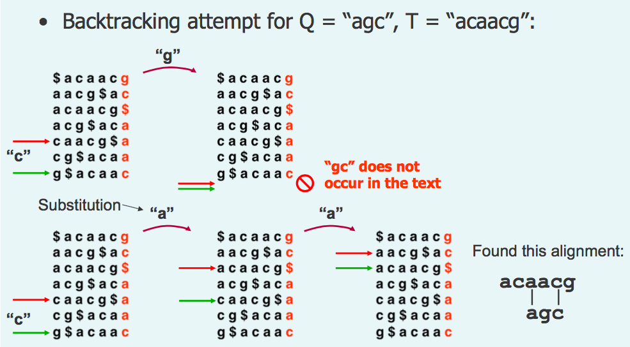
Non-perfect map with BWT: Backtrack
Ben Langmead NCI Seminar Nov 10, 2008
Notes:
Which version you should use? Concern: what is already processed.. // general the later the better. // Also the annotation files has to be consistent.
If all your data is processed in one version and you try to use processed data from another version.

Slide 14
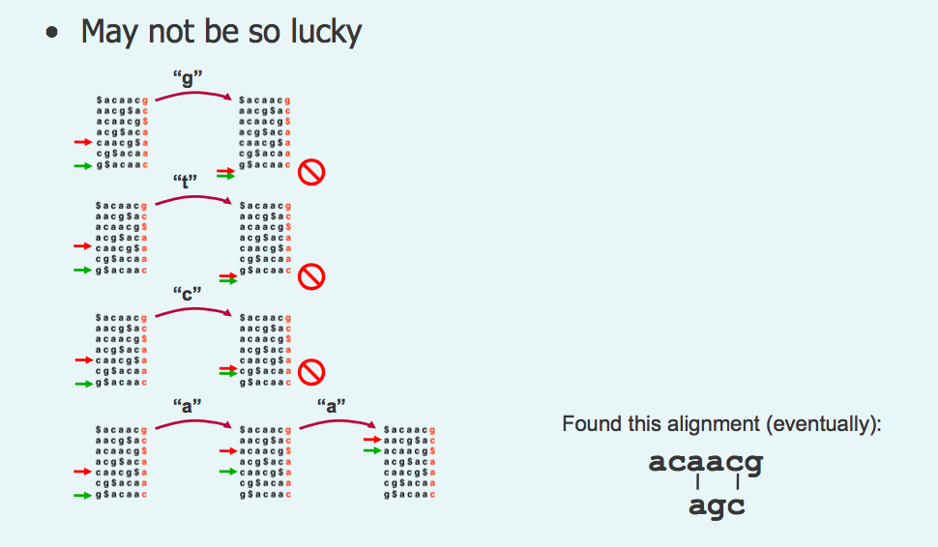
Backtrack may fail when incorrect backtrack nt is used
Ben Langmead NCI Seminar Nov 10, 2008
Notes:
Which version you should use? Concern: what is already processed.. // general the later the better. // Also the annotation files has to be consistent.
If all your data is processed in one version and you try to use processed data from another version.

Slide 15
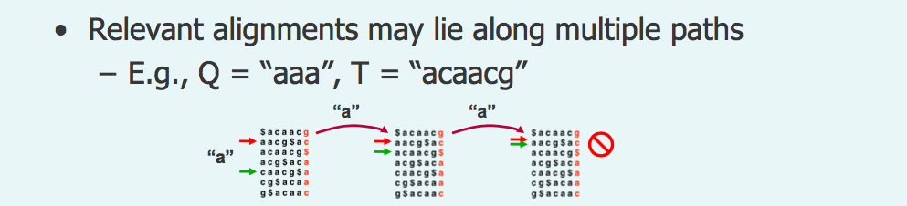
Test: try to backtrack yourself
Ben Langmead NCI Seminar Nov 10, 2008
Notes:
Which version you should use? Concern: what is already processed.. // general the later the better. // Also the annotation files has to be consistent.
If all your data is processed in one version and you try to use processed data from another version.

Slide 16
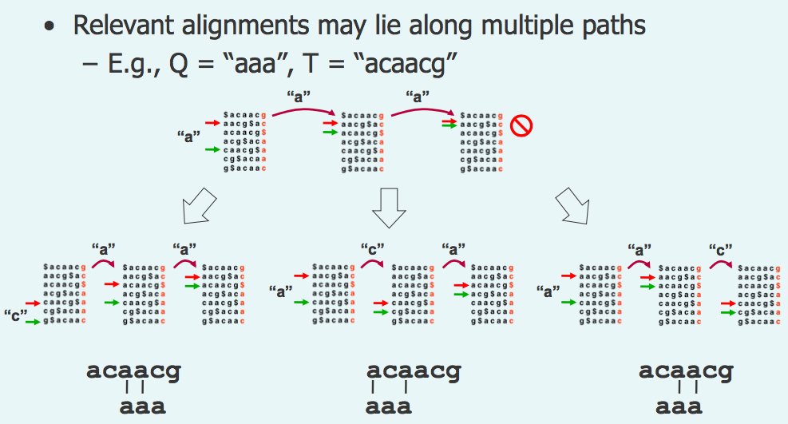
Did you get all these solutions?
Ben Langmead NCI Seminar Nov 10, 2008
Notes:
Which version you should use? Concern: what is already processed.. // general the later the better. // Also the annotation files has to be consistent.
If all your data is processed in one version and you try to use processed data from another version.

Slide 17
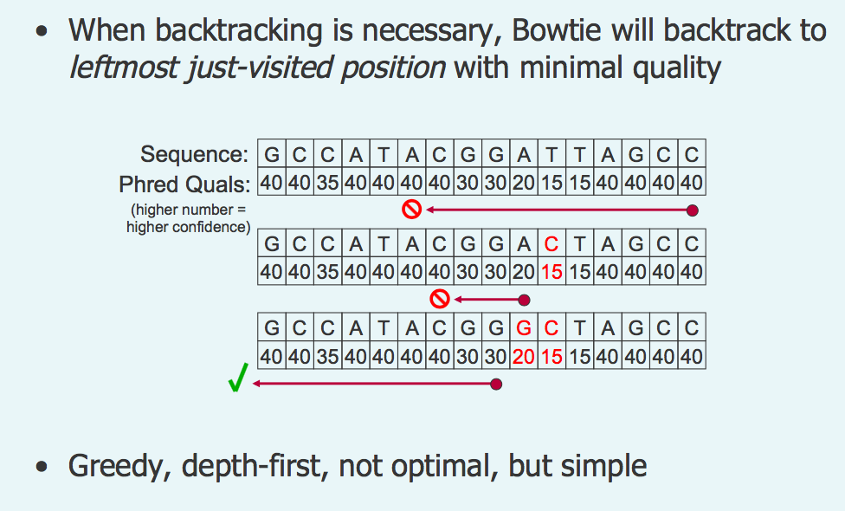
Practical optimization for backtrack
Ben Langmead NCI Seminar Nov 10, 2008
Notes:
Which version you should use? Concern: what is already processed.. // general the later the better. // Also the annotation files has to be consistent.
If all your data is processed in one version and you try to use processed data from another version.

Slide 18

Different version of BWA
Type | When to use it?
BWA backtrack | Read length < 70nt
BWA MEM | Most of other cases
BWA SW | When gaps are frequent
http://bio-bwa.sourceforge.net/bwa.shtml

Slide 19
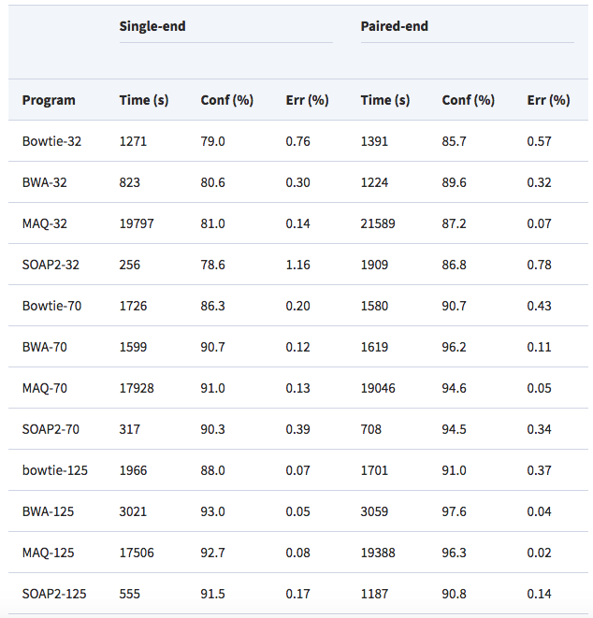
Performance comparison
Li et al. Bioinformatics, 2009

Slide 20
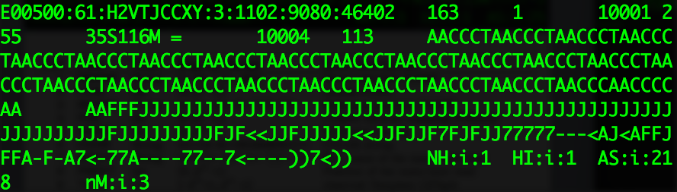
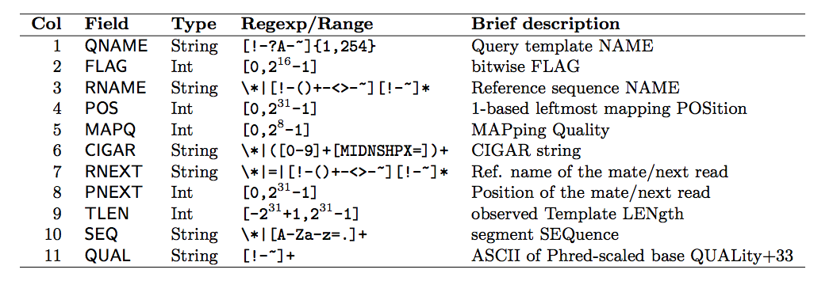
Standard alignment output format: SAM
SAM

Slide 21
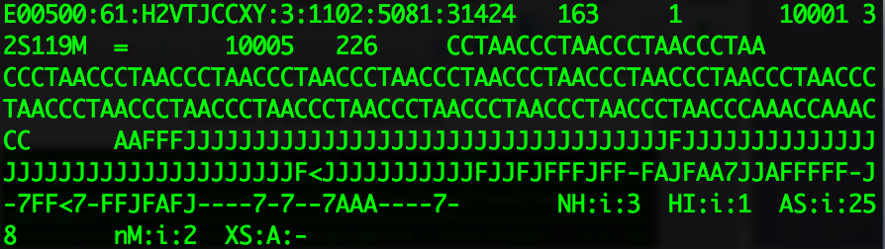
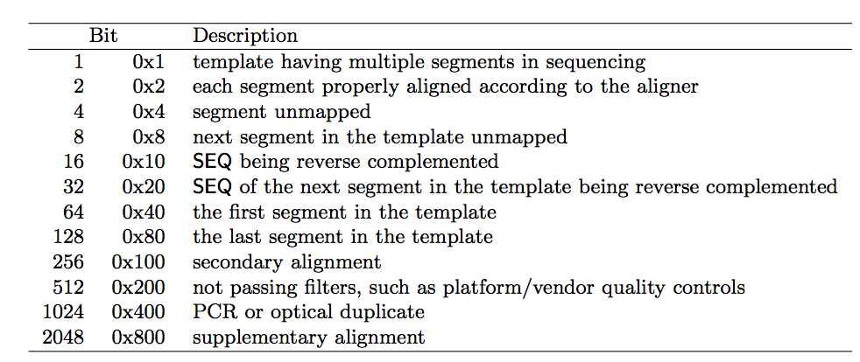
SAM FLAG number

Slide 22
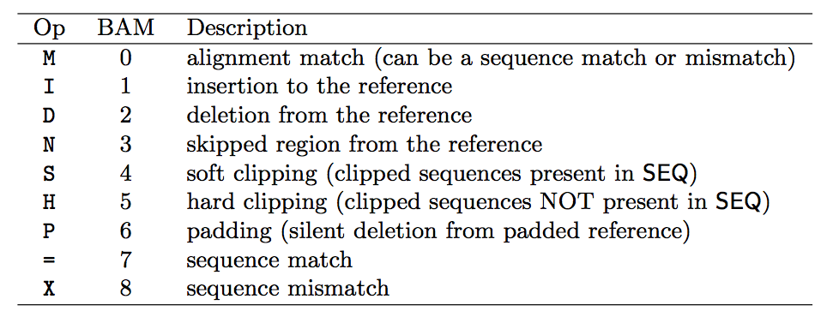
SAM CIGAR string

Slide 23
Common Tools to work with SAM/BAM file
samtools view in1.bam | more
samtools view aln.sorted.bam chr2:20,100-20,200
samtools sort -@ 10 -T /tmp/aln.sorted -o aln.sorted.bam aln.bam
samtools index aln.sorted.bam
samtools mpileup -gf ref.fasta in1.bam
samtools tview aln.sorted.bam chr2:20,100-20,200
http://www.htslib.org/doc/samtools.html

Slide 24
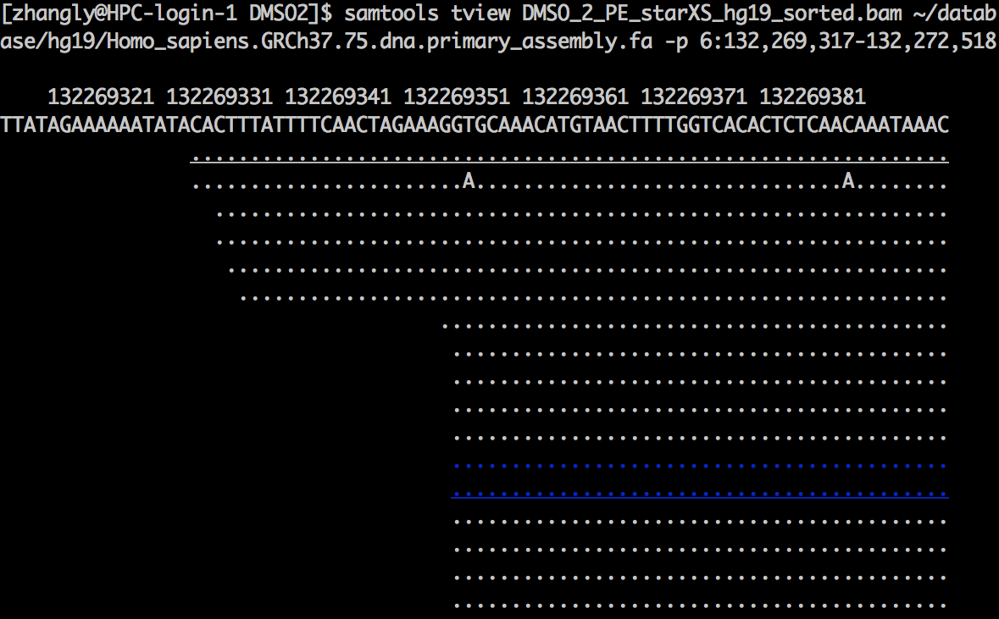
View alignment information organized by the coordinate on the server with samtools

Slide 25
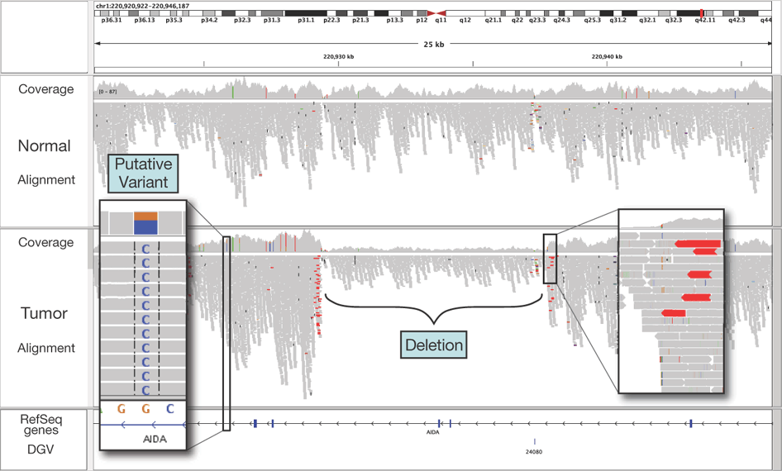
IGV genome browser

Slide 26
week2.class1
1. Introduction about the short read alignment algorithm
2. Introduction about quality control on sequencing data in general

Slide 27
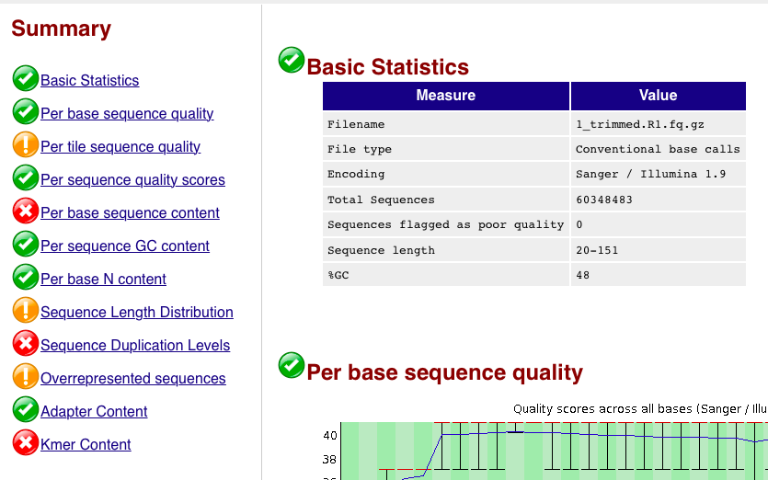
Fastqc QC on raw reads level

Slide 28
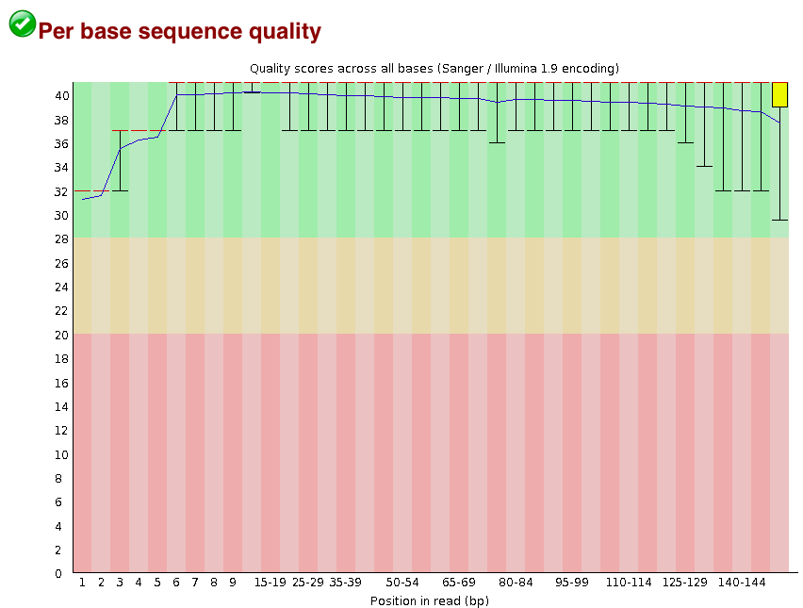
Sequencing Quality Score(positive case)

Slide 29
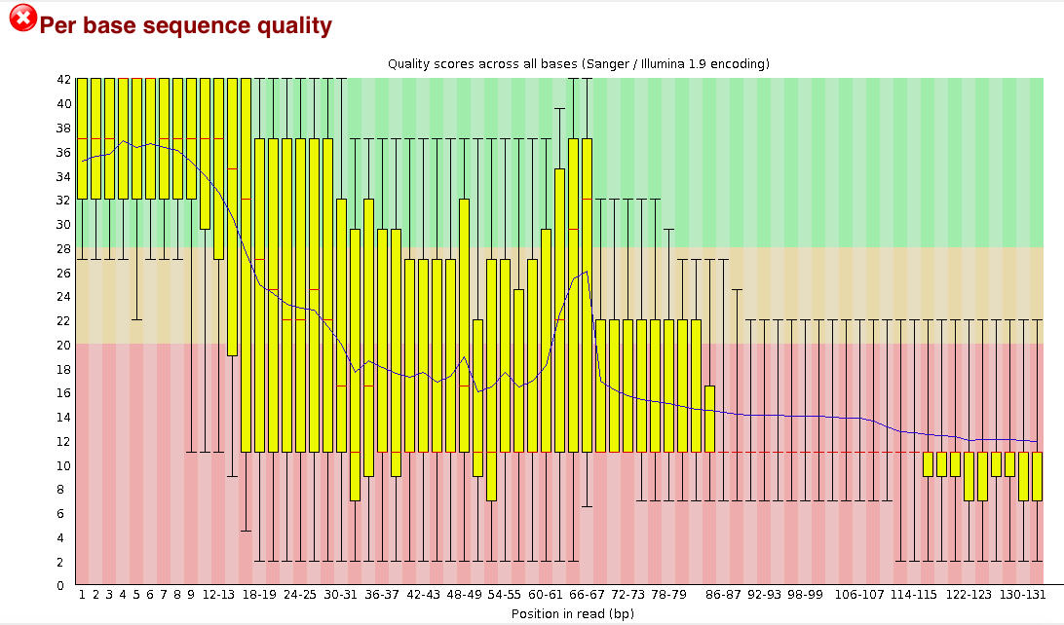
Sequencing Quality Score(negative case)

Slide 30
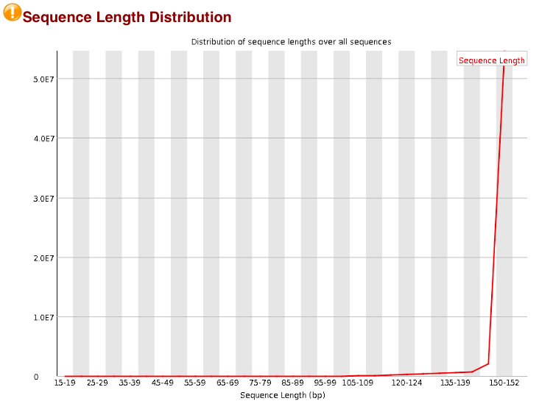
Post-trimming Read length distribution (positive case)

Slide 31
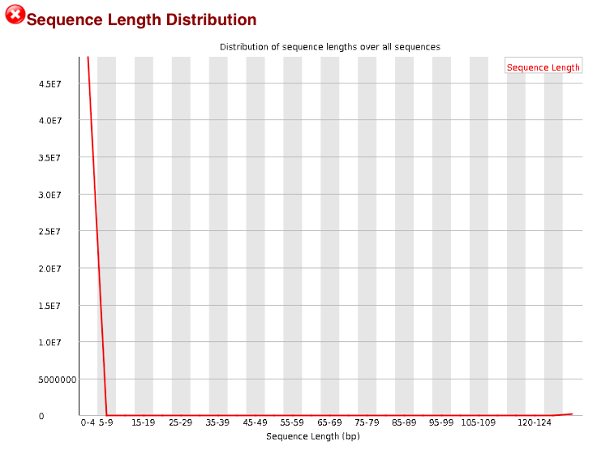
Post-trimming Read length distribution (negative case)

Slide 32
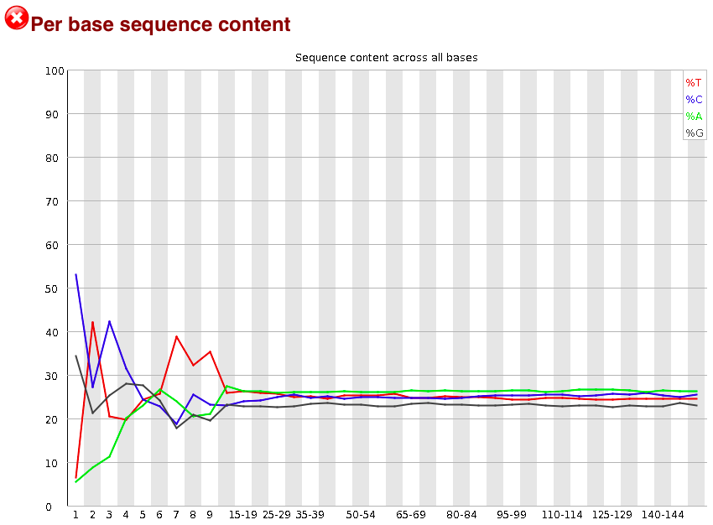
Sequencing nucleotide content (Positive example)
Bioinformatics and Functional genomics, 3rd, page 139

Slide 33
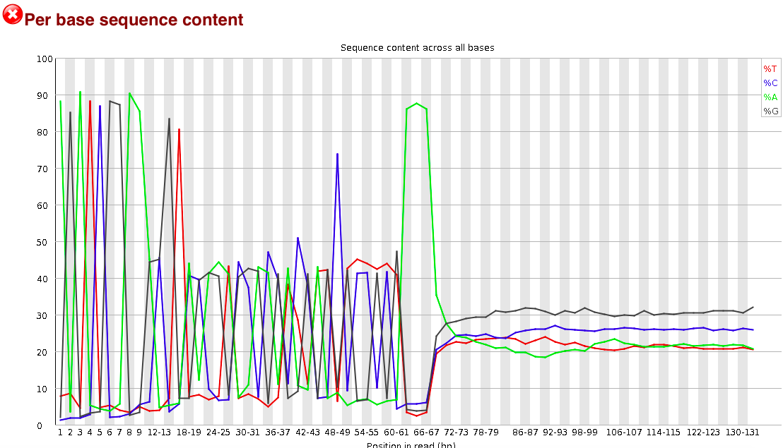
Sequencing nucleotide content (negative example)

Slide 34
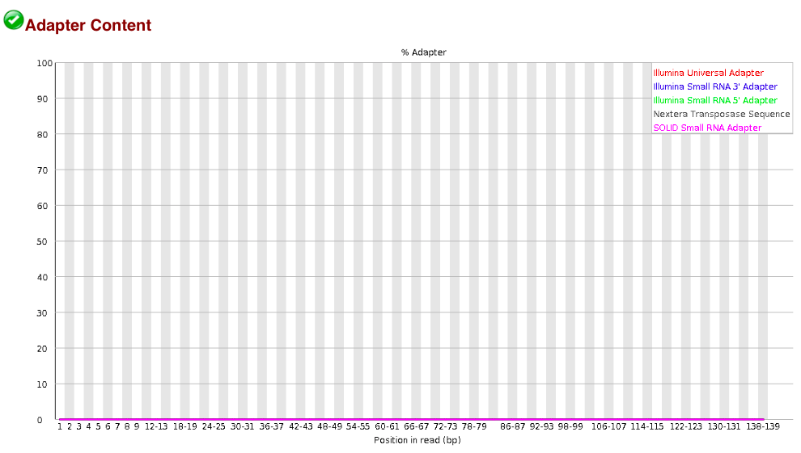
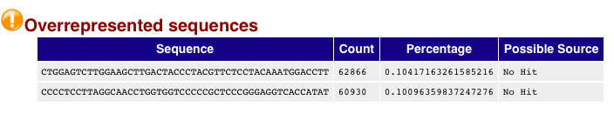
Adaptor or overrepresented sequences(positive)
Notes:
When you talk about any algorithm you have to consider two things: (1) how many steps (2) how much memory it has to store.
There are clever algorithm, but you need to know them as well.

Slide 35
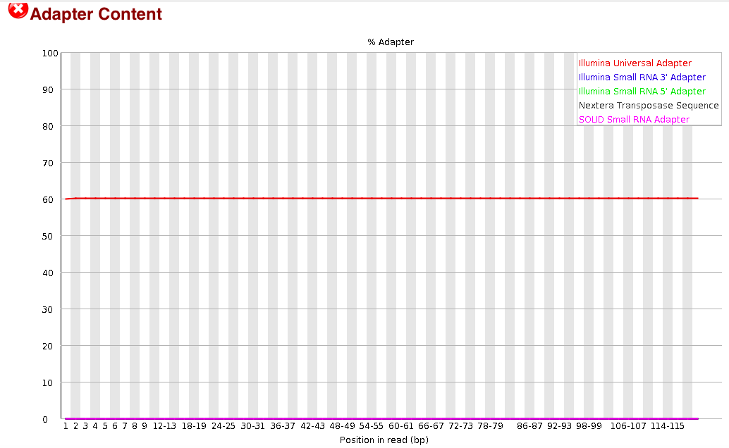
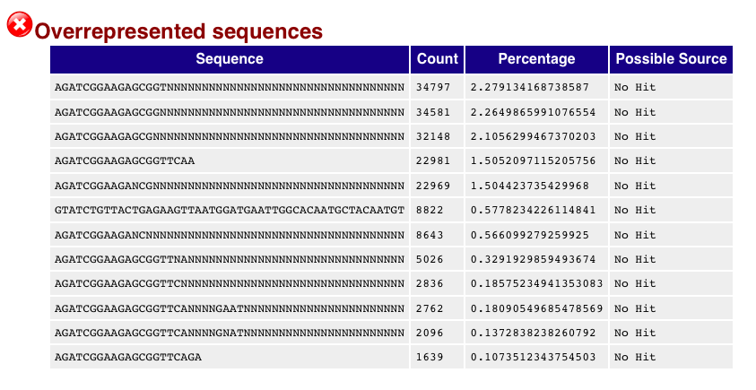
Adaptor or overrepresented sequences(negative)
Notes:
When you talk about any algorithm you have to consider two things: (1) how many steps (2) how much memory it has to store.
There are clever algorithm, but you need to know them as well.

Slide 36
Post-alignment stage QC
Item to check
Mapping %
Uniquely mapping %
Experiment specific QCs

Slide 37
Take home messages for this class
1. BWT algorithm
2. SAM format
3. How to perform QC on sequencing data

Slide 38
After class read/videos (optional)
1. PacBio mechanism videos
2. detailed explanation of BLAST
3. more explanation about the O() in algorithm

Slide 39
Pre-class read/videos
1. RNA-Seq videos

Slide 40
Backup slides

Slide 41
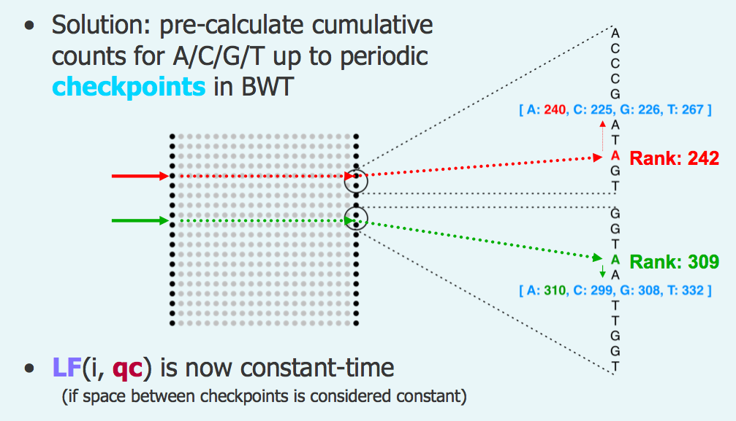
Further speed up the algorithm by set checking point in FM Index
Ben Langmead NCI Seminar Nov 10, 2008
Notes:
Which version you should use? Concern: what is already processed.. // general the later the better. // Also the annotation files has to be consistent.
If all your data is processed in one version and you try to use processed data from another version.

